Slide 1

FRAUD DETECTION PROJECT
LOGISTIC REGRESSION
RANDOM FOREST
XGBOOST
ANN
MODEL DEPLOYMENT
G2 – Capstone Project3

Slide 2
CONTENT
Group Members
Data Analysis
EDA
Logistic Regression without SMOTE
Logistic Regression with SMOTE
Random Forest Classifier without SMOTE
Random Forest Classifier with SMOTE
XGB Classifier without SMOTE
XGB Classifier with SMOTE
ANN
Model Deployment

Slide 3
Group Member
F3662-Muhsin
F3634-İbrahim

Slide 4
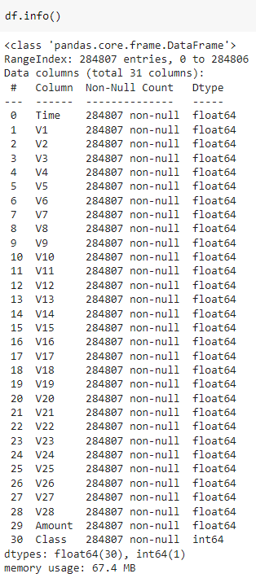
DATA ANALYSIS
Records : 284.807
Rows : 30
Duplicates: 1081

Slide 5
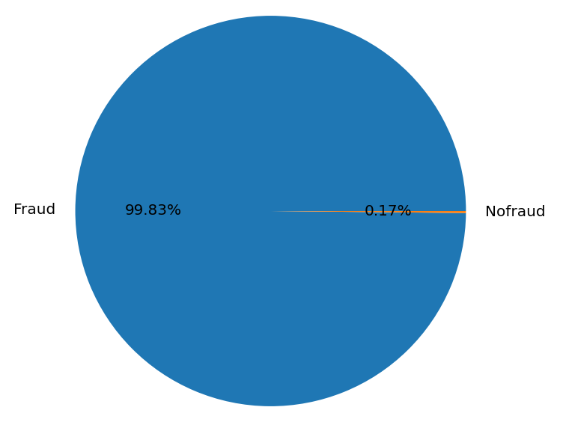
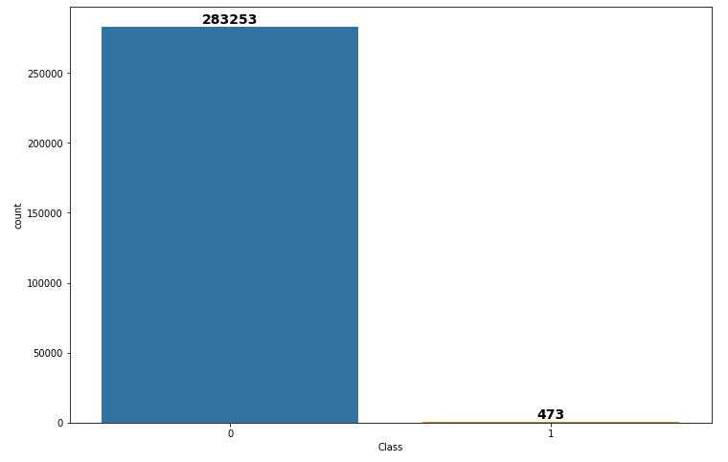
DATA ANALYSIS

Slide 6
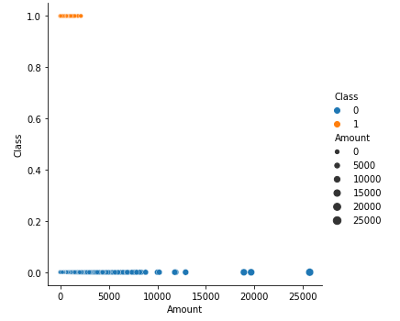
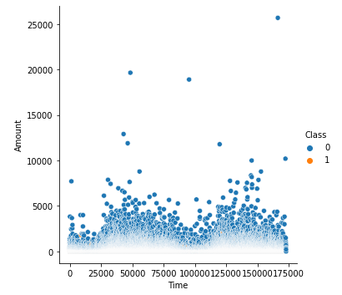
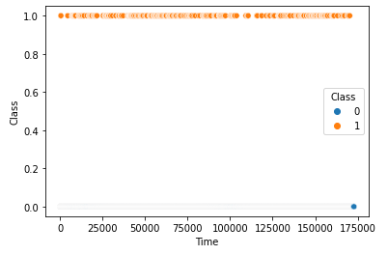
DATA ANALYSIS

Slide 7
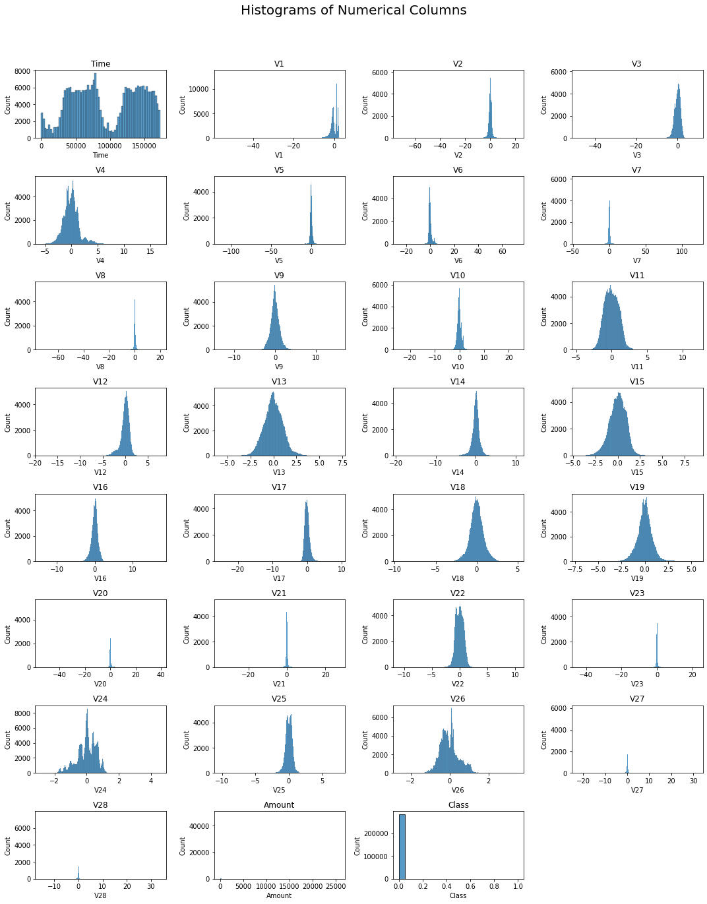
DATA ANALYSIS

Slide 8
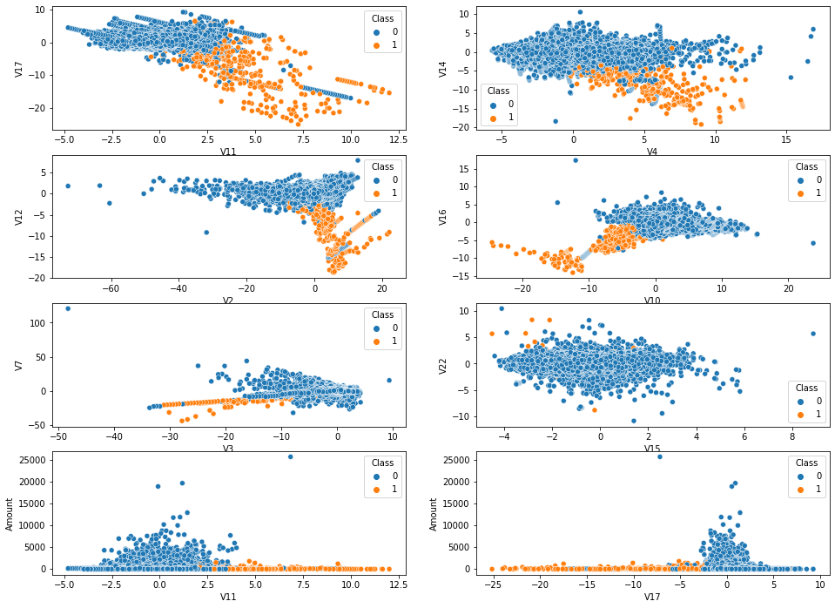
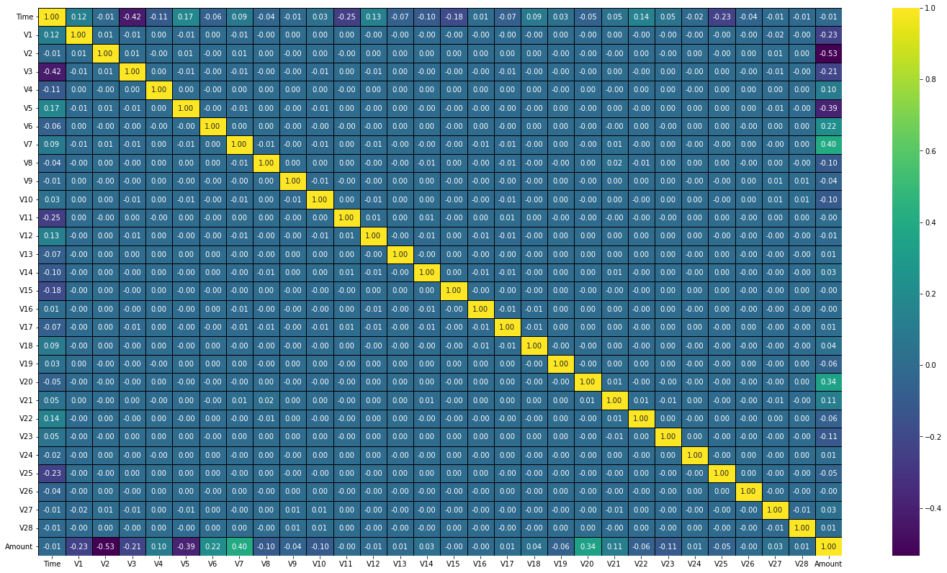
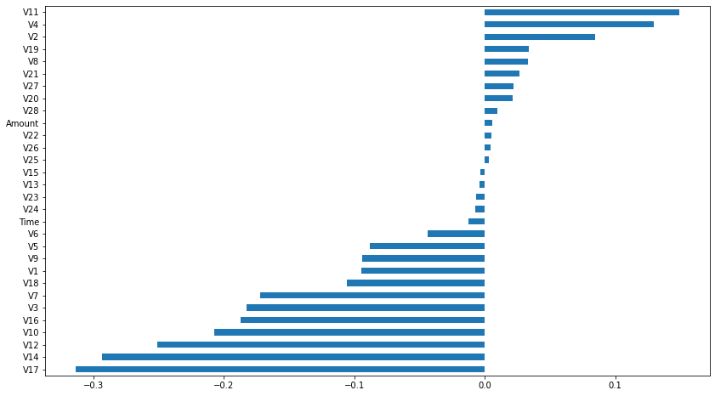
DATA ANALYSIS

Slide 9

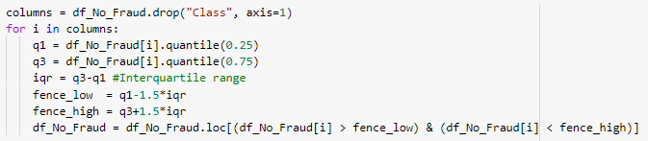
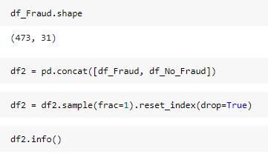
EDA

Slide 10
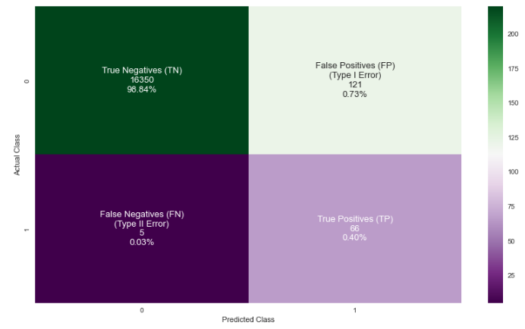
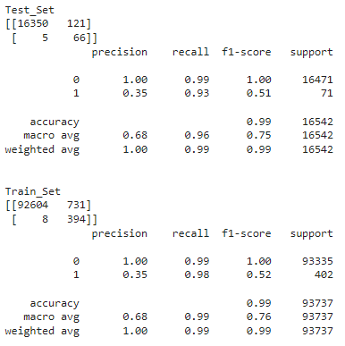
Logistic Regression without SMOTE

Slide 11
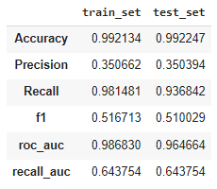
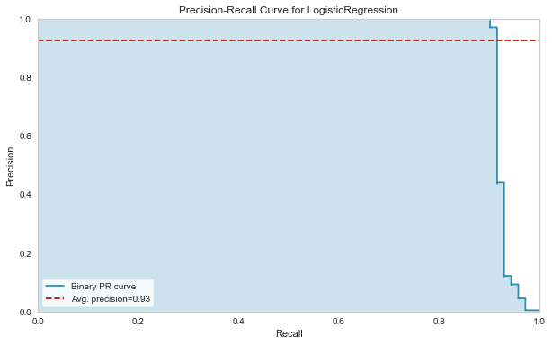
Logistic Regression without SMOTE

Slide 12
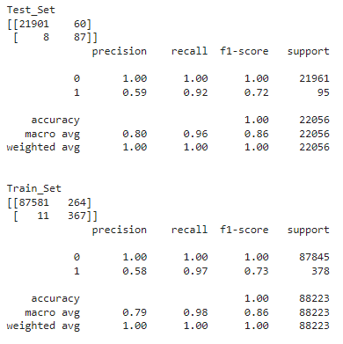
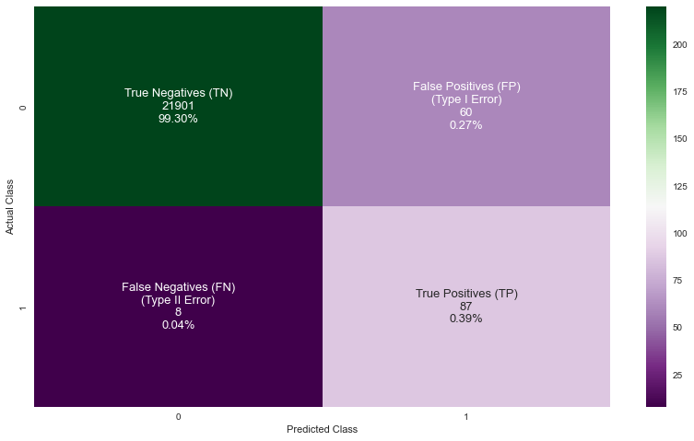
Logistic Regression with SMOTE

Slide 13
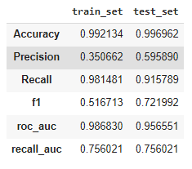

Logistic Regression with SMOTE

Slide 14
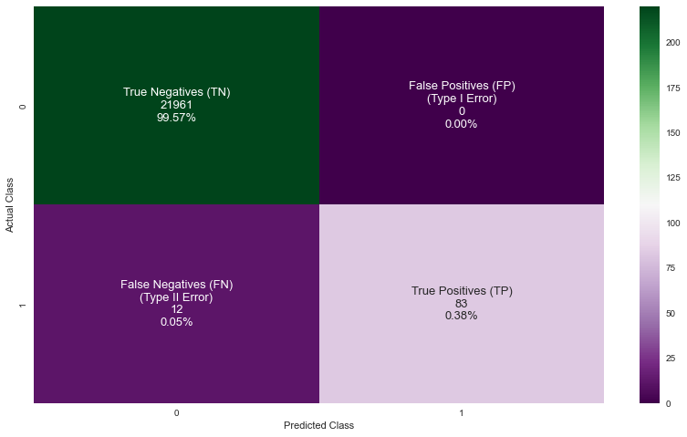
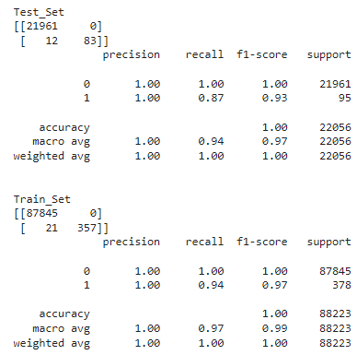
Random Forest Classifier without SMOTE

Slide 15
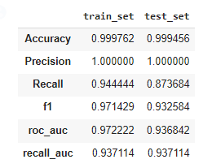
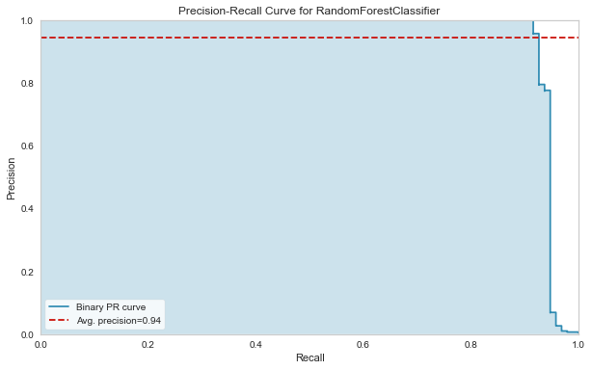
Random Forest Classifier with SMOTE

Slide 16
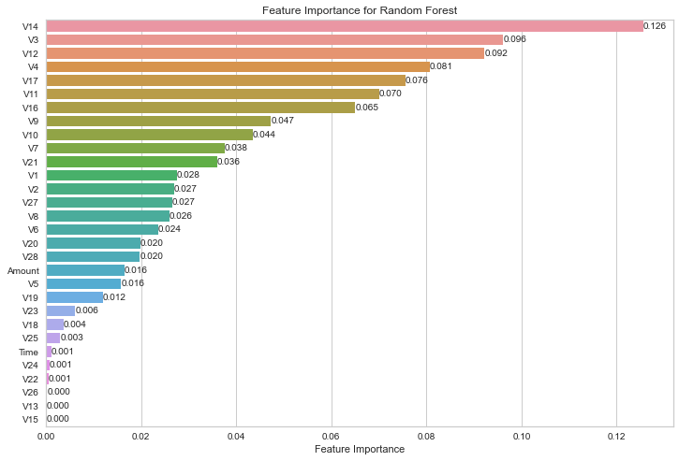
Random Forest Classifier with SMOTE Feature-Importance

Slide 17
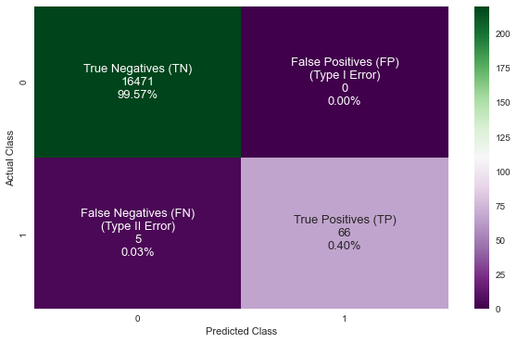
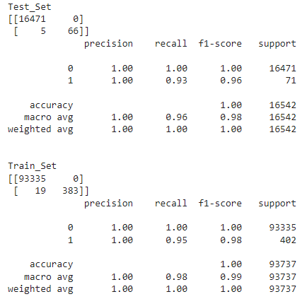
XGB Classifier without SMOTE

Slide 18
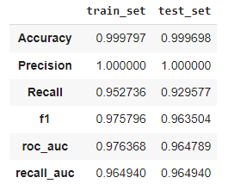
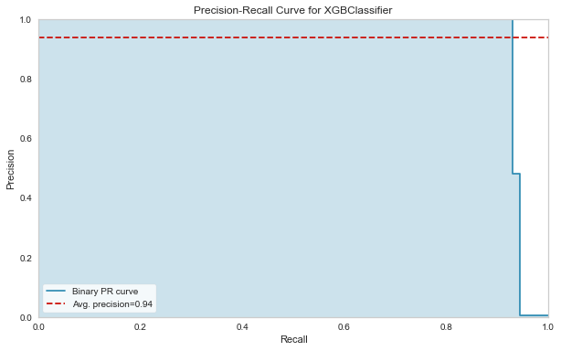
XGB Classifier without SMOTE

Slide 19

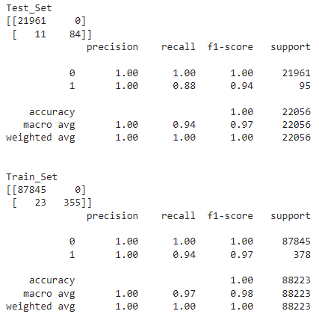
XGB Classifier with SMOTE

Slide 20
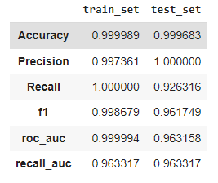
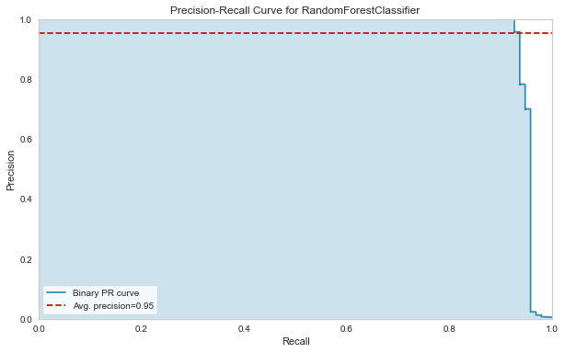
XGB Classifier with SMOTE

Slide 21
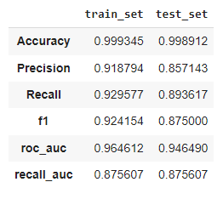
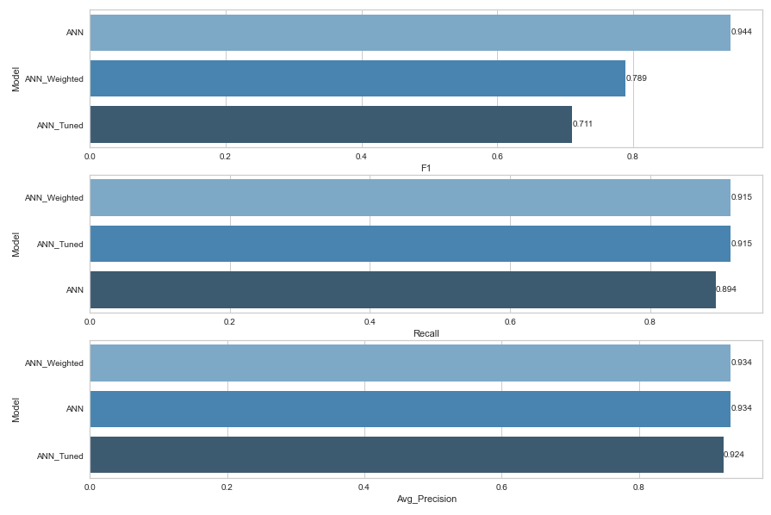
ANN

Slide 22
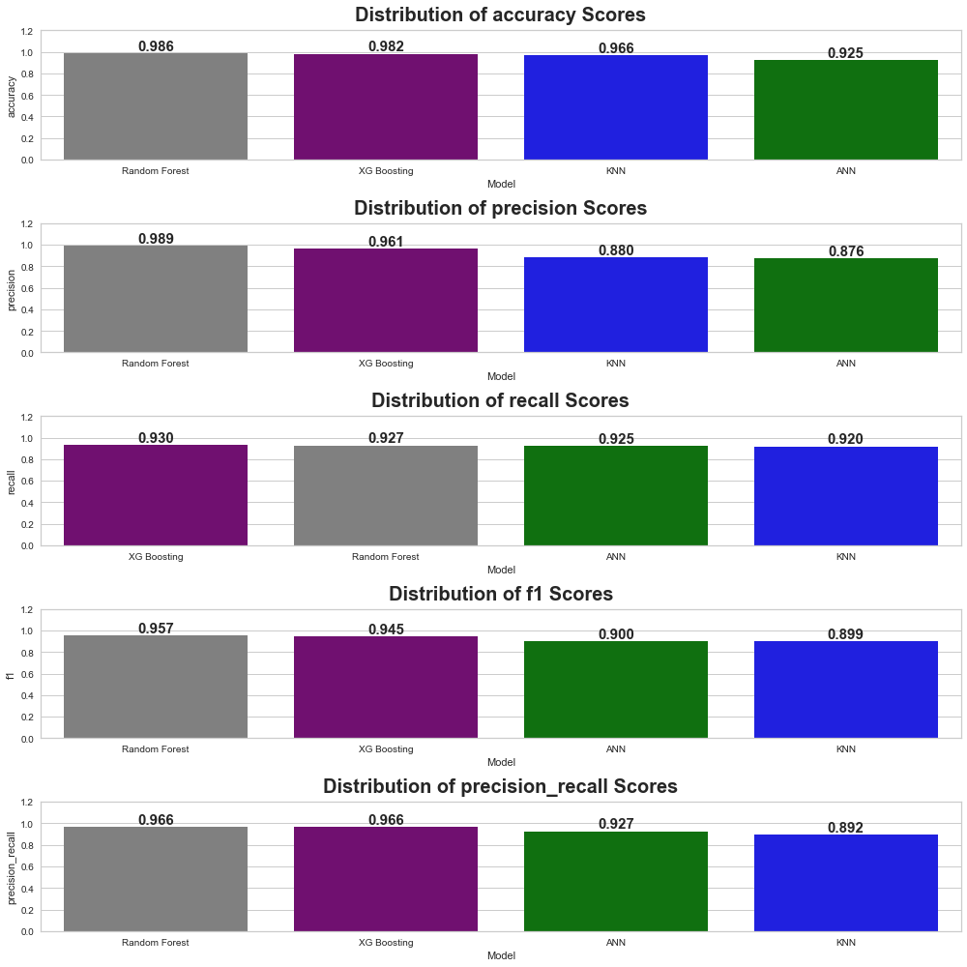
COMPARISON OF MODELS

Slide 23
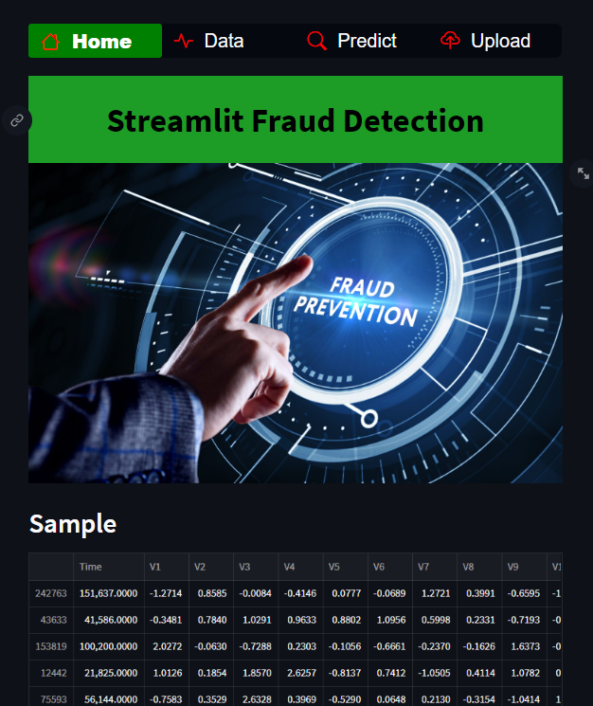
MODEL DEPLOYMENT

